Slide 1
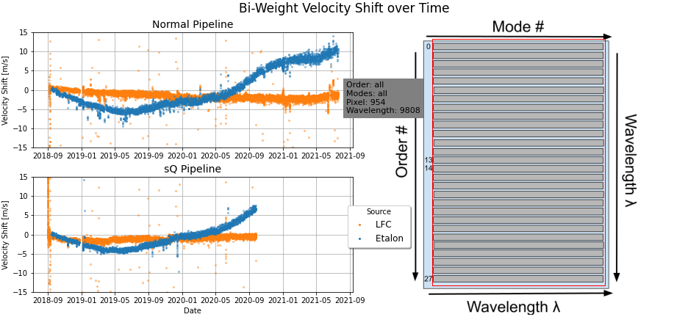
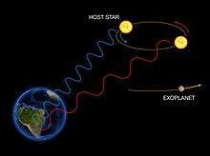
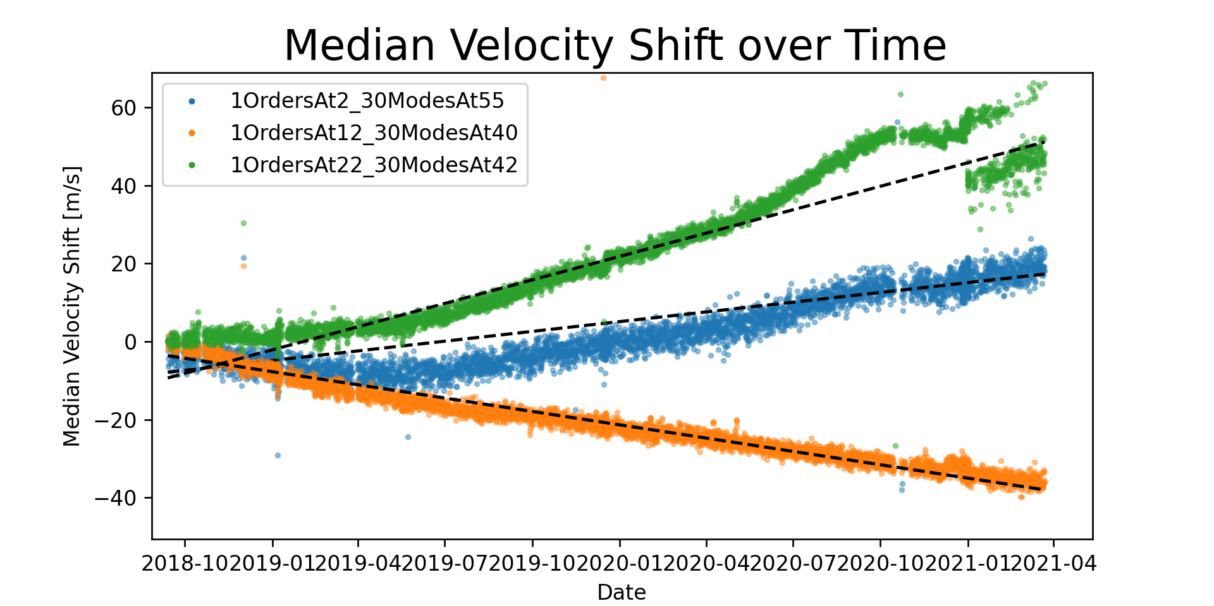
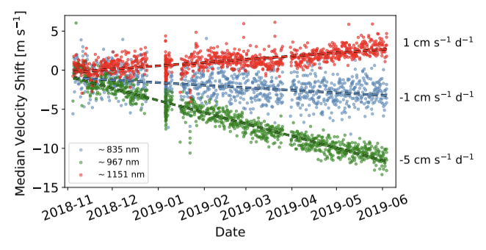
Investigating the modal drift of the Habitable Planet Finder Astro-Etalon calibration system
Ben Turner, Ryan Terrien, Ally Keen and Katy Oda
Introduction and Importance
Methods
Results and Reflection
The Habitable Planet Finder (HPF) system:
What: an astronomical spectrograph equipped with both an Astro-etalon and a Laser Frequency Comb (LFC) calibration system at McDonald Observatory in Texas
Purpose: observes M-Dwarf stars in search of Earth-like planets.
How: observing the star’s motion via the radial-velocity (RV) method to identify orbiting planets.
Both LFCs and etalons can achieve the high-precision measurements to identify Earth-like planets. However, despite being more affordable, etalons exhibit a wavelength-dependent modal drift over time in their spectra as shown below.
As the cost-effective calibration system for astronomical spectroscopy, understanding the drifts seen in etalon spectra are crucial to further the search for Earth-like planets around M-Dwarfs.
General Goal: identify patterns in drift behavior to hypothesis why they occur.
Specific Goal: to extend the analysis seen in Terrien et al. and identify any changes in the drift behavior recently.
I did this using Python via Jupyter Notebooks and data collected by the HPF calibration systems.
The Process:
use Gaussian fit on each mode of the HPF calibration spectra
create code with Python packages to calculate the modal drift in equivalent Doppler shift
plot these drift/Doppler shift/RV values over the last two years
repeat for each calibration system, pipeline, and section of the spectrograph
While improving analysis techniques, I recreated Fig. 2 from Terrien et al. and extended the data to April 2021 as seen below.
To isolate for etalon-specific behavior, I did this analysis for four different sets of data: both the HPF etalon and LFC spectra processed normally and then processed with a new coding pipeline.
I analyzed different sections (meaning different wavelengths) of the HPF spectrograph (averaged a group of modes) to identify the chromatic behavior indicated in Terrien et al.
By the end of my research period, I had built up code and techniques that allowed me to quickly and easily generate RV calibration plots for any part of the HPF spectrograph. These plots tell us how that group of modes has drifted from its position on the spectrograph in 2018.
As seen from Fig. 3 and Fig.4, the drift behavior is becoming more extreme over time. Also, in Fig. 3, a bimodal pattern recently emerged but only in certain areas of the spectrograph.
Although the source of the drift was not identified in this research, a multitude of HPF specific problems were highlighted. Fixing these at HPF is crucial so we can be confident in any Doppler measurements made and no discoveries are discredited due to poor calibration. Further research is required in order to diagnose and fix not only HPF problems, but for any Astro-etalon systems.
Figure 1
The Doppler shift in wavelength of the light from the target star as the star “wobbles” due to the gravitational pull of an exoplanet (RV method).
https://www.google.com/url?sa=i&url=https%3A%2F%2Fen.wikipedia.org%2Fwiki%2FDoppler_spectroscopy&psig=AOvVaw0jlCitXWdaa4xRj44hOUX-&ust=1632267333663000&source=images&cd=vfe&ved=0CAsQjRxqFwoTCMjY9ebbjvMCFQAAAAAdAAAAABAD
Figure 4
The median velocity shift averaged over all modes and orders in the HPF spectrograph for Etalon and LFC, processed two different ways.
Figure 3
Extending drift analysis of the three averages of 30 modes across the spectrograph to April 2021. Fig. 2 can be seen in the black box.
Figure 2
The median RV drift of etalon calibration spectra averaged over 30 modes around 835nm, 967nm, and 1151nm. Data from the HPF spectrograph over 1.5 years and analysis by Terrien et al.
Citations
Wikipedia, Doppler Spectroscopy (Fig. 1)
Terrien et al, 2021 (Fig. 2)

